Slide 1

Artificial Intelligence: Pathfinding

Slide 2
Introduction
Almost every game requires pathfinding
Agents must be able to find their way around the game world
Pathfinding is not a trivial problem
The fastest and most efficient pathfinding techniques tend to consume a great deal of resources

Slide 3
Pathfinding algorithms
Follow-walls-left, Follow-walls-right
Random-Trace, bug logic
Breadth-First
Best-First
Dijkstra
A* algorithm

Slide 4
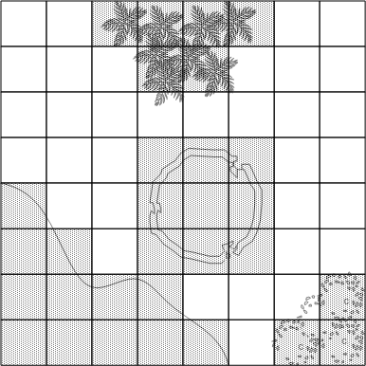
Grids
2D grids – intuitive world representation
Works well for many games including some 3D games such as Warcraft III
Each cell is flagged as either passable or and obstacle.
Fast look-up: get to any (row,col) in constant time.
Easy and quick access to neighboring cells: (row-1, col) for above,
(row, col+1) to the right, (row+1, col) below and (row, col-1) to the left.

Slide 5
Searching for a Path
A path is a list of cells, points, or nodes that an agent must traverse
A pathfinding algorithm finds a path
From a start position to a goal position
The following pathfinding algorithms can be used on
Grids
Waypoint graphs
Navigation meshes for more complex spaces

Slide 6
Criteria for Evaluating Pathfinding Algorithms
Quality of final path
Resource consumption during search
CPU and memory
Whether it is a complete algorithm
A complete algorithm guarantees to find a path if one exists

Slide 7
Random Trace – the bug AI
Simple algorithm
Agent moves towards goal
If goal reached, then done
If obstacle
Trace around the obstacle clockwise or counter-clockwise (pick randomly) until free path towards goal
Repeat procedure until goal reached

Slide 8
Random Trace Characteristics
Not a complete algorithm (may not find a path at all)
Found paths are unlikely to be optimal
Incapable of considering a wide variety of paths
Consumes very little memory

Slide 9
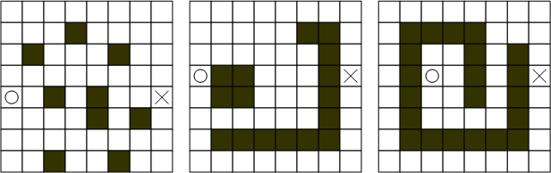
Random Trace (continued)
How will Random Trace do on the following maps?

Slide 10
Progress towards Understanding A*
To understand A*
First understand Breadth-First, Best-First, and Dijkstra algorithms
A* is a combination of Best-First and Dijkstra
These algorithms use nodes to represent candidate paths
They keep track of numerous paths simultaneously

Slide 11
Progress towards Understanding A*
public class Node
{
private Node parent;
private int x,y; //position of where the node is ((x,y) pixel space, or (row,col) grid space)
...
}
The parent member is used to chain nodes sequentially together to represent a path

Slide 12
Progress towards Understanding A*
All of the following algorithms use two lists
The open list
The closed list
Open list keeps track of promising nodes
When a node is examined from open list
Taken off open list and checked to see whether it has reached the goal
If it has not reached the goal
Used to create additional nodes
Then placed on the closed list
The closed nodes are those that do not correspond to the goal cell and have been processed already

Slide 13
Overall Structure of the Algorithms
1. Create start point node – push onto open list
2. While open list is not empty
A. Pop node from open list (call it currentNode)
B. If currentNode corresponds to goal, break from step 2
C. Create new nodes (successors nodes) for cells around currentNode and push them onto open list
D. Put currentNode onto closed list

Slide 14
Main different between 5 pathfinding algorithms
Breadth-First always processes the node that has been waiting the longest
Best-First always processes the one that is closest to the goal
Dijkstra processes the one that is the cheapest to reach from the start cell
A* chooses the node that is cheap and close to the goal

Slide 15
Breadth-First
Finds a path from the start to the goal by examining the search space step by step
It checks all the cells that are one step from the start, and then checks cells that are two plies from the start, and so on.
This is because the algorithm always processes the node that has been waiting the longest.
It uses a queue as the open list
Once a node is created, it is pushed to the back of the queue
So that the node at the front of the queue is always the one that has been waiting the longest

Slide 16
Breadth-First Characteristics
Exhaustive search
Systematic, but not clever
Consumes substantial amount of CPU and memory
Guarantees to find paths that have fewest number of nodes in them
Not necessarily the shortest distance!
Search as hard in the direction away from the goal as it does toward the goal
Complete algorithm

Slide 17
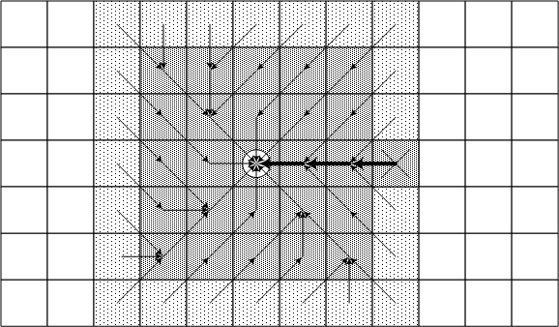
Bread-First example

Slide 18
Best-First
Uses problem specific knowledge to speed up the search process
Head straight for the goal
Computes the distance of every node to the goal
Uses the distance (or heuristic cost) as a priority value to determine the next node that should be brought out of the open list

Slide 19
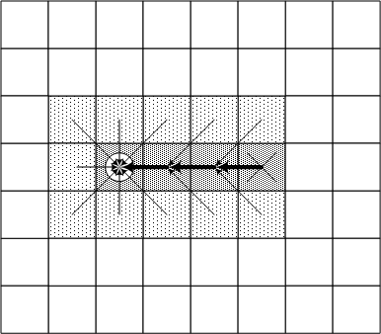
Best-First (continued)

Slide 20
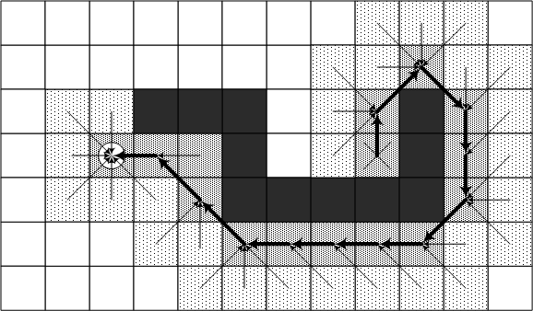
Best-First (continued)
Situation where Best-First finds a suboptimal path

Slide 21
Best-First Characteristics
Heuristic search
Uses fewer resources than Breadth-First
Tends to find good paths
No guarantee to find most optimal path
Complete algorithm

Slide 22
Dijkstra
Disregards distance to goal
Keeps track of the cost of every path
No guessing
Computes accumulated cost paid to reach a node from the start
Uses the cost (called the given cost) as a priority value to determine the next node that should be brought out of the open list

Slide 23
Dijkstra Characteristics
Exhaustive search
At least as resource intensive as Breadth-First
Always finds the most optimal path
Complete algorithm

Slide 24
Dijkstra’s Algorithm
Vertex | Distance | Predecessor | Processed
s
w
x
u
v
t
Dijkstra(Graph G, Vertex source)
initialize distances to $∞$
mark source as distance 0
mark all vertices unprocessed
while(there are unprocessed vertices){
let u be the closest unprocessed vertex
foreach(edge (u,v) leaving u){
if(u.dist+weight(u,v) < v.dist){
v.dist = u.dist+weight(u,v)
v.predecessor = u
}
}
mark u as processed
}
1
1
w
x
1
s
u
v
t
20
1
1

Slide 25
Dijkstra’s Algorithm
Vertex | Distance | Predecessor | Processed
s | 0 | -- | Yes
w | 1 | s | Yes
x | 2 | w | Yes
u | 20 3 | s x | Yes
v | 4 | u | Yes
t | 5 | v | Yes
Dijkstra(Graph G, Vertex source)
initialize distances to $∞$
mark source as distance 0
mark all vertices unprocessed
while(there are unprocessed vertices){
let u be the closest unprocessed vertex
foreach(edge (u,v) leaving u){
if(u.dist+weight(u,v) < v.dist){
v.dist = u.dist+weight(u,v)
v.predecessor = u
}
}
mark u as processed
}
1
1
w
x
1
s
u
v
t
20
1
1

Slide 26
A*
It uses an admissible heuristic function that never overestimates the true cost
Uses both heuristic cost (the estimated cost to reach the goal) and given cost (the actual cost paid to reach a node from the start) to order the open list
Final Cost = Given Cost + (Heuristic Cost * Heuristic Weight)

Slide 27
A* cont’
Final Cost = Given Cost + (Heuristic Cost * Heuristic Weight)
Heuristic weight can be used to control the amount of emphasis on the heuristic cost versus the given cost.
It can control whether A* should behave more like Best-First or Dijkstra.
If hw=0, final cost will be the given cost ->Dijkstra
If hw >>1, it will behave just like Best-First

Slide 28
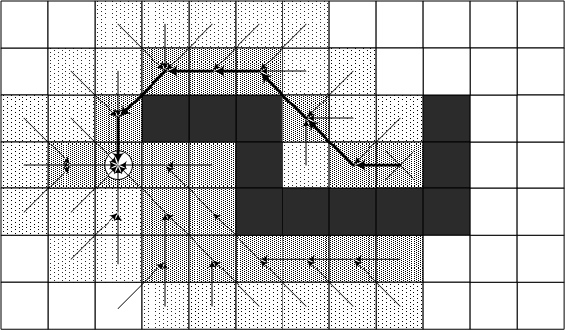
A* (continued)
Avoids Best-First trap!

Slide 29
A* Characteristics
Heuristic search
On average, uses fewer resources than Dijkstra and Breadth-First
Admissible heuristic guarantees it will find the most optimal path
Complete algorithm

